Slide 1
M5 Forecasting
Estimate the unit sales of Walmart retail goods
Luli Lee
luli245683@g.ncu.edu.tw

Slide 2
Overview of the Competition
M-Competition is short of the Makridakis Competitions.
We need to predict sales data provided by the retail giant Walmart 28 days into the future.

Slide 3
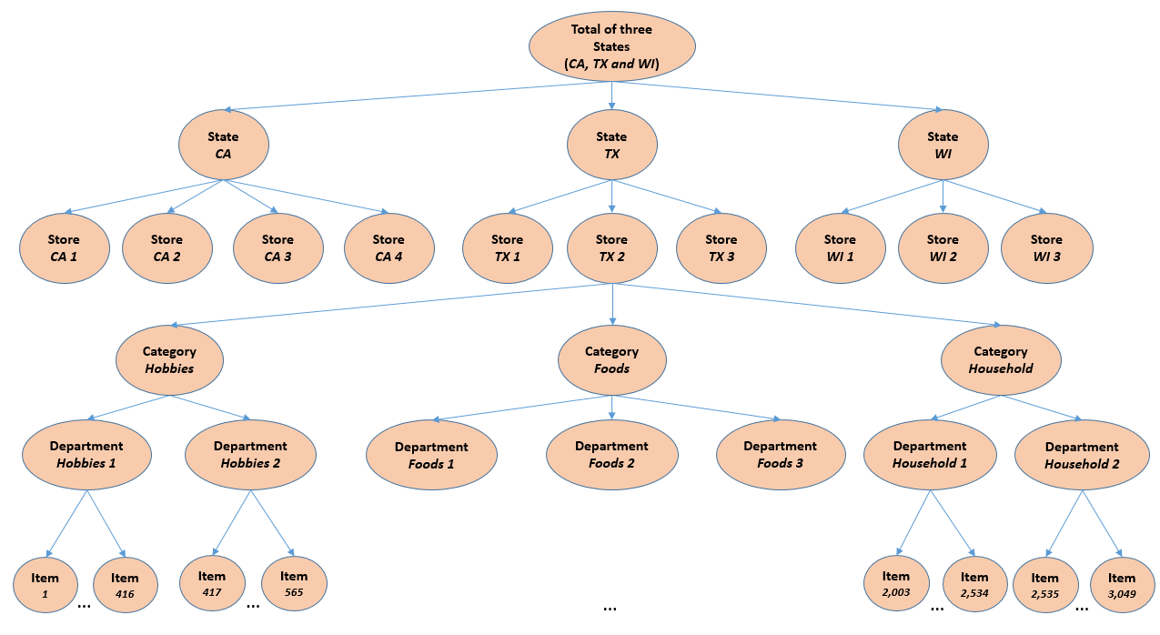
Dataset
The dataset contains several hierarchical sales data provided by Walmart.
It involves 3,049 products,
3 product categories,
7 product departments,
10 stores,
located in three States

Slide 4
Dataset
This dataset contains three csv files:
Calendar contains information about the dates on which the products are sold.
Sales train contains the historical daily unit sales data per product and store.
Sell prices contains information about the price of the products sold per store and date.

Slide 5
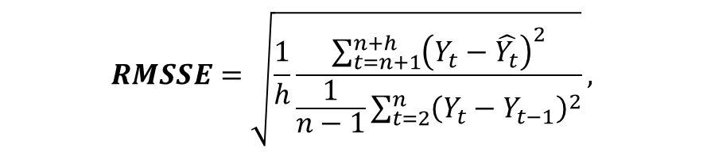
Evaluation
The accuracy of the point forecasts will be evaluated using the Root Mean Squared Scaled Error (RMSSE), which is a variant of the well-known Mean Absolute Scaled Error (MASE) proposed by (Hyndman and Koehler, 2006).
$$RMSSE=\sqrt{\frac{1}{h}\frac{\sum_{t=n+1}^{n+h}{{\left(Y_{t}−\hat{Y_{t}}\right)}^{2}}}{\frac{1}{n−1}\sum_{t=2}^{n}{{\left(Y_{t}−Y_{t−1}\right)}^{2}}}},$$
Some of my opinion I wrote in this notebook (Continually updated). about the evaluation metric of the competition.

Slide 6
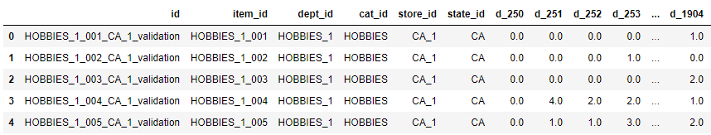
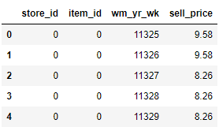
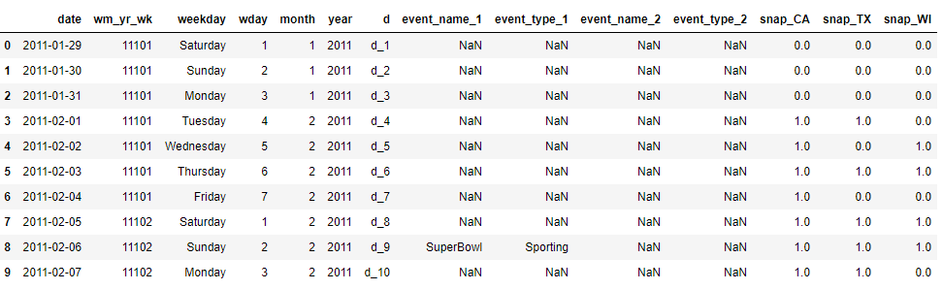
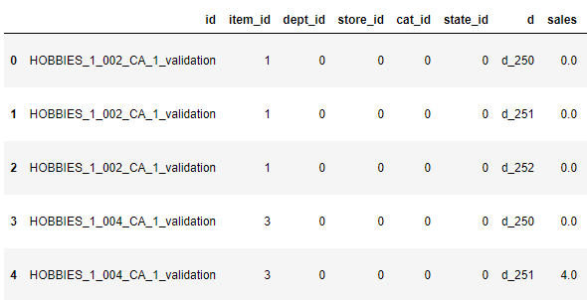
Data Transformation
3. Merge two dataframe with date.
1. Melting the data
2. Merge two dataframe with column d

Slide 7

Feature Engineering
- Label Encoding
For categorical values such as event type, department, and state.
one-hot encoding | Label encoding
High memory consumption | Less memory consumption
Features are independent for each other. | Features have relations/comparisons between them.
The categorical feature is not ordinal | The categorical feature is ordinal

Slide 8
Feature Engineering
- Datetime Features
These are components of the time step itself for each observation.
In this case, the portion of Datetime features are list below:
Weekday
Month of year
Event type
Weekend or not
Quarter, Season
Holiday, Festival

Slide 9
Feature Engineering
- Lag Features
These are values at prior time steps.
In this case, I choose the two prior time steps, week-on-week (7) and month-on-month (28).
People's shopping habits of shopping this Sunday are similar to the previous Sunday such as buying roast chicken.
People's shopping habits in the 1st weekend of a month shop look similar to the first weekend of other months instead of the previous weekend.
Notes:
了解生活習慣 文化而後才能決定如何取得特徵

Slide 10
Feature Engineering
- Rolling Window Features
These are a summary of values over a fixed window of prior time steps.
The more similar trend of weeks is, the more similar the prediction it will be.
The number of average sales within the whole week can hint how normal the whole week was.

Slide 11
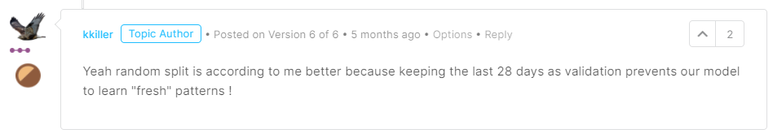
Dataset split
We expect our model should focus the patterns on given features instead of the continuous trend of a prior time.

Slide 12
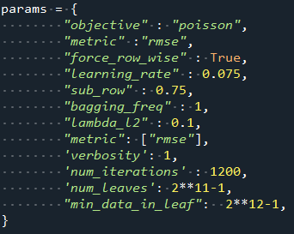
Modeling
Recurrent Neural Networks
Boosting Tree models - LightGBM
Neural Networks
Poisson regression assumes the response variable Y has a Poisson distribution.

Slide 13
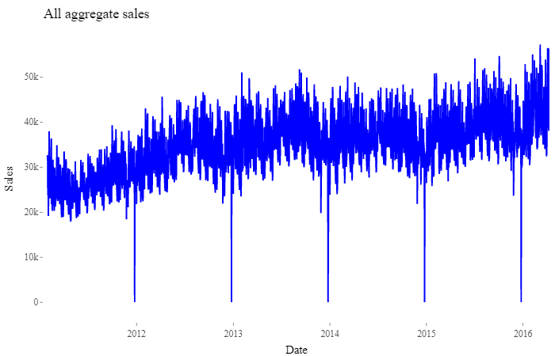
Exploratory Data Analysis
The Walmart close its stores on December 25.
The sale amounts of 2016 exceed previous years.
But the predictions of the model never exceeds the highest amount in all training data.
The awesome visualization is provide by this link
Notes:
可納入每年GDP作為特徵

Slide 14
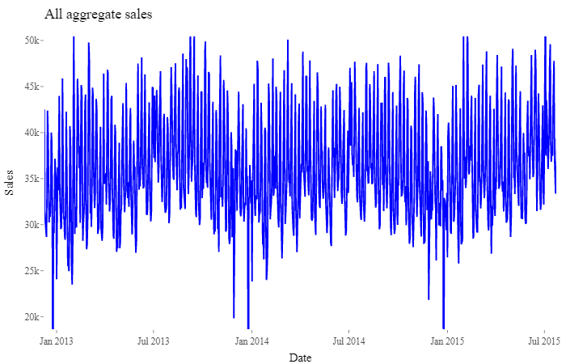
Exploratory Data Analysis
As we can see, the seasonality shows a strong effect.
Notes:
datetime feature中的月份可以涵蓋到這部分的學習
但是由於不同地區的四季有所不同
所以應該可以將其納入考量

Slide 15
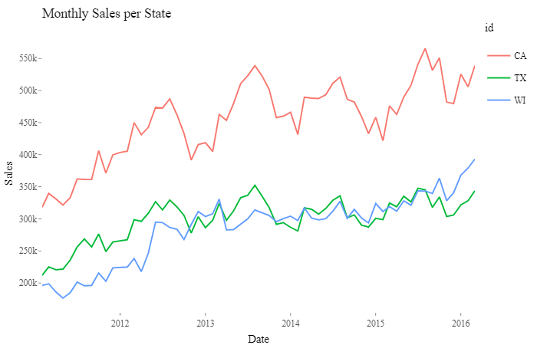
Exploratory Data Analysis
The number of sales from California is significantly exceeds the other states.
Should the model need to take all stores into consideration?
Notes:
可納入外部資料: 各州人口 年齡分布

Slide 16
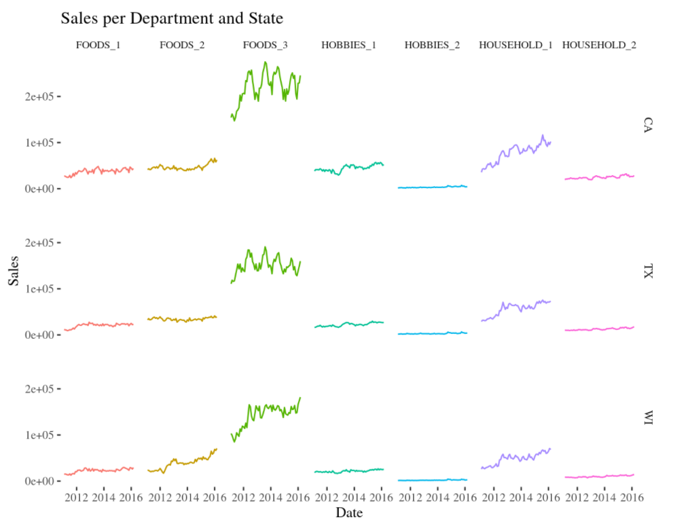
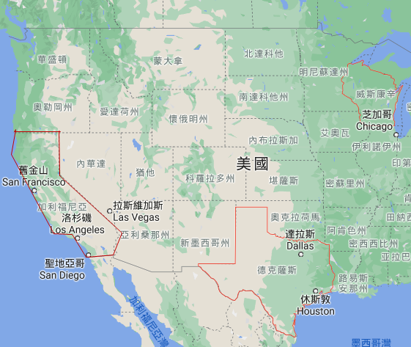
Exploratory Data Analysis
The FOODS_3 should be affected by seasonality.
Notes:
可納入外部特徵: 經緯度 每月平均氣溫 等

Slide 17
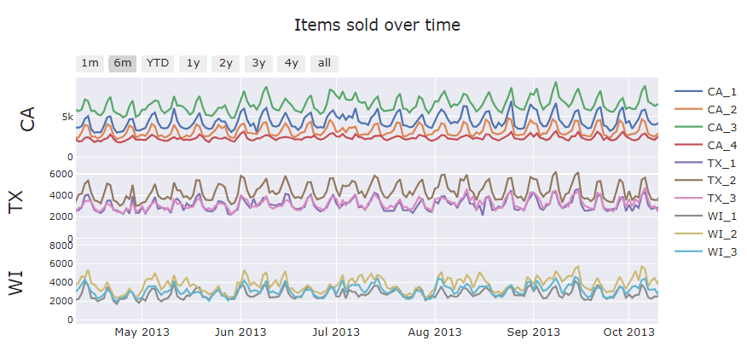
Exploratory Data Analysis
The trends of the amount of sold are almost the same if the store located in Wisconsin.
Notes:
可以將不同的store分開訓練分類器

Slide 18
Summary
There is no dataset that can contain all information around the world.
Some of the rules are what we should teach machines, instead of expecting them will learn.
The rank of competition is not mean that its predictions will actually close to the trend of the future.

Slide 19
Reference
“9 Things You Should Do Every Sunday.” facilethings.com. https://facilethings.com/blog/en/9-things-you-should-do-every-sunday (September 11, 2020).
“Back to (Predict) the Future - Interactive M5 EDA | Kaggle.” https://www.kaggle.com/headsortails/back-to-predict-the-future-interactive-m5-eda (September 11, 2020).
“Categorical Encoding | One Hot Encoding vs Label Encoding.” 2020. Analytics Vidhya. https://www.analyticsvidhya.com/blog/2020/03/one-hot-encoding-vs-label-encoding-using-scikit-learn/ (September 11, 2020).
“M5 Forecasting Kaggle Competition #3 Modelling.” 2020. Yaolong’s Blog. https://yaolong.blog/2020/08/10/m5-forecasting-kaggle-competition-3-modelling/ (September 11, 2020).
Wang, Ming-Hwa, Teng Gao, Huimin Li, and Wenya Xie. “M5 Forecasting - Accuracy Estimate the Unit Sales of Walmart Retail Goods.” : 59.
Brownlee, Jason. 2016. “Basic Feature Engineering With Time Series Data in Python.” Machine Learning Mastery. https://machinelearningmastery.com/basic-feature-engineering-time-series-data-python/ (September 11, 2020).
“M5 First Public Notebook Under 0.50.” https://kaggle.com/kneroma/m5-first-public-notebook-under-0-50 (September 11, 2020).

